Slide 1

Unit-02
Control Structure, Function and Array
Object Oriented Programming using Java (2304CS302)
CO2 : At the end of this course, students will be able to,
apply the concept of array and control structure to solve the problem.
Prof. Chirag K Sakhrani
Department of Computer Applications
chirag.sakhrani@darshan.ac.in
8401191184

Slide 2

Outline
Control Structure
  If statement
  If-else statement
  If-else ladder statement
  Switch statement
  While loop
  Do-while loop
  For
  Foreach
  Break
  Continue
Array
  One Dimensional Array
  Multi Dimensional Array
Function
Looping

Slide 3
Control Statements
Control Statements in Java is one of the fundamentals required for Java Programming. It allows the smooth flow of a program.
Statement can simply be defined as an instruction given to the computer to perform specific operations.
A control statement in java is a statement that determines whether the other statements will be executed or not.
Control statements in Java,
  If statement
  If-else statement
  If-else ladder statement
  Switch statement

Slide 4
if statement
if statement tests the condition. It executes the if block if condition is true.
Start
public class IfStatementDemo{
  public static void main(String[] ar)
  {
    int a = 10, b = 20;
    if( a < b ) {
    System.out.println("A is smaller than B");
    }
  }
}
Condition
True
False
Statements
Next Statements
End

Slide 5
if-else statement
if-else statement also tests the condition. It executes the if block if condition is true otherwise else block is executed.
Start
public class IfElseStatementDemo{
  public static void main(String[] ar)
  {
    int a = 10, b = 20;
    if(a<b) {
    System.out.println("A is smaller than B");
    }
    else {
    System.out.println(“A is not smaller than B");
    }
  }
}
Condition
True
False
Statements
Statements
Next Statements
End

Slide 6
if-else-if ladder statement
if-else-if ladder statement executes one condition from multiple statements.
Start
Cndtn 1
False
Cndtn 2
False
Cndtn 3
False
True
True
True
Statements
Statements
Statements
Statements
Next Statements
End

Slide 7
if-else-if ladder statement
public class IfElseStatementDemo{
  public static void main(String[] ar)
  {
int marks = 65;
if (marks < 60) {
System.out.println("fail");
} else if (marks >= 60 && marks < 80) {
System.out.println("B grade");
} else if (marks >= 80 && marks < 90) {
System.out.println("A grade");
} else if (marks >= 90 && marks < 100) {
System.out.println("A+ grade");
} else {
System.out.println("Invalid!");
}
  }
}

Slide 8
Nested If statement
We can also use if/else if statement inside another if/else if statement, this is known as nested if statement.
Start
True
Condition 1
False
Condition 2
Condition 3
True
False
True
False
Statements
Statements
Statements
Statements
Next Statements
End

Slide 9
Nested If statement
public class IfElseStatementDemo{
  public static void main(String[] ar)
  {
int username = Integer.parseInt(args[0]);
int password = Integer.parseInt(args[1]);
double balance = 123456.25;
if(username==1234){
  if(password==987654){
  System.out.println("Your Balance is ="+balance);
  }
  else{
  System.out.println("Password is invalid");
  }
}
else{
System.out.println("Username is invalid");
}
  }
}

Slide 10
switch statement
switch statement executes one statement from multiple conditions. It is like if-else-if ladder statement.
Start
Condition 1
True
Statement 1
False
Condition 2
True
Statement 2
False
True
Condition 3
Statement 3
False
Default Statements
Next Statements
End

Slide 11
switch statement
public class SwitchExampleDemo {
  public static void main(String[] args)
  {
    int number = 20;
    switch (number) {
      case 10:
      System.out.println("10");
      break;
      case 20:
        System.out.println("20");
        break;
      default:
      System.out.println("Not 10 or 20");
    }
  }
}

Slide 12
Programs to perform (Conditional Statements)
Write a Java program to get a number from the user and print whether it is positive or negative.
Write a program to find maximum no from given 3 no.
The marks obtained by a student in 5 different subjects are input through the keyboard.
  The student gets a division as per the following rules:
    Percentage above or equals to 60-first division
    Percentage between 50 to 59-second division
    Percentage between 40 and 49-Third division
    Percentage less than 40-fail
    Write a program to calculate the division obtained by the student.
Write a Java program that takes a number from the user and displays the name of the weekday accordingly (For example if user enter 1 program should return Monday) .

Slide 13
Looping Statement
Looping in programming languages is a feature which facilitates the execution of a set of instructions/functions repeatedly while some condition evaluates to true.
It is also known as repetitive control structures.
Java provides three ways for executing the loops. While all the ways provide similar basic functionality, they differ in their syntax and condition checking time.
  While loop
  Do-while loop
  For
  Foreach (will cover this after array)

Slide 14
Looping Statement
In for and while loop, test expression is evaluated first and the statement in the loop are executed if condition is true. These loops are entry-controlled or pre-test loop constructs.
If condition because in first occurrence then in this case body of the loop will never execute.
In do….while loop, it evaluates the test expression after executing the statements in a loop. It repeats the loop if the test condition is true. Thus, do…while loop is exit-controlled or post-test loop constructs.
Even if condition becomes false in first occurrence still body of the loop will executes at least once.

Slide 15
While Loop
while loop is used to iterate a part of the program several times.
while is entry control loop.
If the number of iteration is not fixed, it is recommended to use while loop.
//code will print 1 to 9
public class WhileLoopDemo {
  public static void main(String[] args) {
    int number = 1;
    while(number < 10) {
      System.out.println(number);
      number++;
    }
  }
}

Slide 16
Do-while Loop
do-while loop is executed at least once because condition is checked after loop body.
//code will print 1 to 9
public class DoWhileLoopDemo {
  public static void main(String[] args) {
    int number = 1;
    do {
    System.out.println(number);
    number++;
    }while(number < 10) ;
  }
}

Slide 17
For Loop
for loop is used to iterate a part of the program several times.
If the number of iteration is fixed, it is recommended to use for loop.
//code will print 1 to 9
public class ForLoopDemo {
  public static void main(String[] args)
  {
    for(int number=1;number<10;number++)
    {
    System.out.println(number);
    }
  }
}

Slide 18
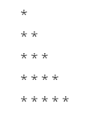
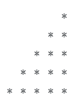

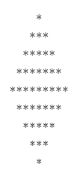
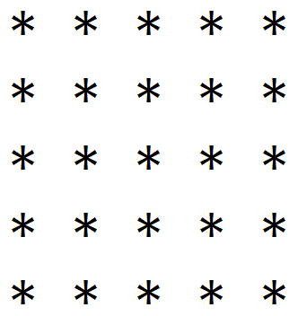
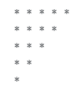

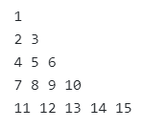


Programs to perform (Looping Statements)
Write a program to print first n odd numbers.
Write a program to check that the given number is prime or not.
Write a program to draw given patterns,

Slide 19
Break statement
When a break statement is encountered inside a loop, the loop is immediately terminated and the program control resumes at the next statement following the loop.
//code will print 1 to 4 followed by “After Loop”
public class BreakDemo{
  public static void main(String[] args)
  {
    for(int number=1;number<10;number++)
    {
      if(number==5) {
        break;
      }
      System.out.println(number);
    }
    System.out.println(“After Loop”);
  }
}

Slide 20
Continue statement
The continue statement is used in loop control structure when you need to immediately jump to the next iteration of the loop. It can be used with for loop or while loop.
//code will print 1 to 9 but not 5, followed by “After Loop”
public class ContinueDemo {
  public static void main(String[] args)
  {
    for(int number=1;number<10;number++)
    {
      if(number==5) {
        continue;
      }
      System.out.println(number);
    }
    System.out.println(“After Loop”);
  }
}

Slide 21
Array
An array is a collection of homogeneous type (similar type) of elements that have contiguous memory location and shares a common name.
Syntax : data_type variable_name[] = new type[size_of_array];
Example : int a[] = new int[10];
  The data_type specifies the type of the elements that can be stored in an array, like int, float, char etc...
  The size_of_array indicates the maximum number of elements that can be stores inside the array.
  In the example, data type of an array is int and maximum elements that can be stored in an array are 10.
35
13
28
106
a
35
42
5
83
97
14
a[0]
a[1]
a[2]
a[3]
a[4]
a[5]
a[6]
a[7]
a[8]
a[9]

Slide 22
Array
Important point about Java array.
  An array is derived datatype.
  An array is dynamically allocated.
  The individual elements of an array is refereed by their index/subscript value.
  The subscript for an array always begins with 0.
We can declare array in various ways:
  int marks[]; //declare array object
  marks=new int[5]; //create array object
  int marks[] = new int[5];
  int [] marks = new int[5];
  int marks[] = {70,80,90};
  int [] marks = {70,80,90};
35
13
28
106
a
35
42
5
83
97
14
a[0]
a[1]
a[2]
a[3]
a[4]
a[5]
a[6]
a[7]
a[8]
a[9]

Slide 23
One-Dimensional Array
An array using one subscript to represent the list of elements is called one dimensional array.
A One-dimensional array is essentially a list of like-typed variables.
Array declaration: type var-name[];
Example: int student_marks[];
Above example will represent array with no value (null).
To link student_marks with actual array of integers, we must allocate one using new keyword.
Example: int student_marks[] = new int[20];

Slide 24
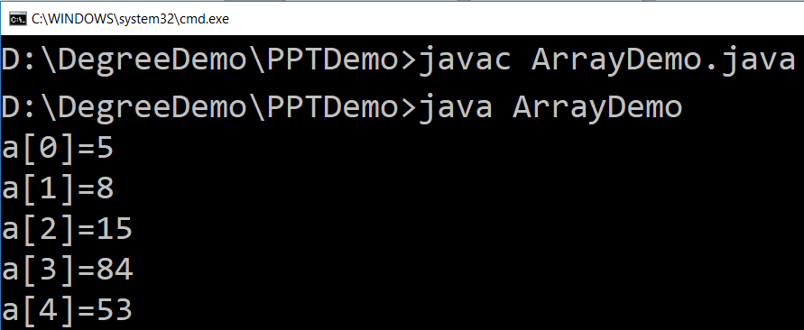
Example (Array)
public class ArrayDemo{
  public static void main(String[] args) {
    int a[]; // or int[] a
    // till now it is null as it does not assigned any memory
    a = new int[5];
    // here we actually create an array
    a[0] = 5;
    a[1] = 8;
    a[2] = 15;
    a[3] = 84;
    a[4] = 53;
    /* in java we use length property to determine the length
    * of an array, unlike c where we used sizeof function */
    for (int i = 0; i < a.length; i++) {
    System.out.println("a["+i+"]="+a[i]);
    }
  }
}

Slide 25
Multi-Dimensional Array
In java, multidimensional array is actually array of arrays.
Example: int runPerOver[][] = new int[3][6];
    length field:
      If we use length field with multidimensional array, it will return length of first dimension.
      Here, if runPerOver.length is accessed it will return 3
      Also if runPerOver[0].length is accessed it will be 6
First Over (a[0])
4
0
1
3
6
1
a[0][0]
a[0][1]
a[0][2]
a[0][3]
a[0][4]
a[0][5]
1
1
0
6
0
4
Second Over (a[1])
a[1][0]
a[1][1]
a[1][2]
a[1][3]
a[1][4]
a[1][5]
2
1
1
0
1
1
Third Over (a[2])
a[2][0]
a[2][1]
a[2][2]
a[2][3]
a[2][4]
a[2][5]

Slide 26
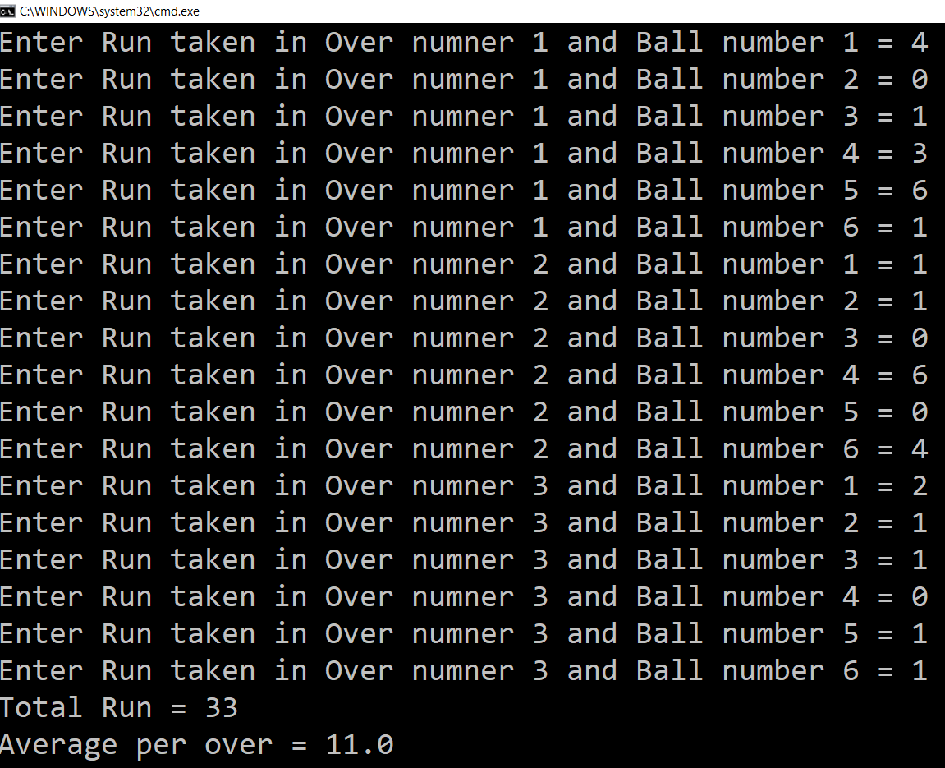
Multi-Dimensional Array (Example)
Scanner s = new Scanner(System.in);
int runPerOver[][] = new int[3][6];
for (int i = 0; i < 3; i++) {
  for (int j = 0; j < 6; j++) {
    System.out.print("Enter Run taken" +
    " in Over numner " + (i + 1) +
    " and Ball number " + (j + 1) + " = ");
    runPerOver[i][j] = s.nextInt();
  }
}
int totalRun = 0;
for (int i = 0; i < 3; i++) {
  for (int j = 0; j < 6; j++) {
  totalRun += runPerOver[i][j];
  }
}
double average = totalRun / (double) runPerOver.length;
System.out.println("Total Run = " + totalRun);
System.out.println("Average per over = " + average);

Slide 27
Multi-Dimensional Array
manually allocate different size:
    int runPerOver[][] = new int[3][];
    runPerOver[0] = new int[6];
    runPerOver[1] = new int[7];
    runPerOver[2] = new int[6];
initialization:
  int runPerOver[][] = {
  {0,4,2,1,0,6},
  {1,-1,4,1,2,4,0},
  {6,4,1,0,2,2},
  }
  Note : here to specify extra runs (Wide, No Ball etc.. ) negative values are used

Slide 28
Searching in Array
Searching is the process of looking for a specific element in an array. for example, discovering whether a certain element is included in the array.
Searching is a common task in computer programming. Many algorithms and data structures are devoted to searching.
We will discuss two commonly used approaches,
  Linear Search: The linear search approach compares the key element key sequentially with each element in the array. It continues to do so until the key matches an element in the array or the array is exhausted without a match being found.
  Binary Search: The binary search first compares the key with the element in the middle of the array. Consider the following three cases:
    If the key is less than the middle element, you need to continue to search for the key only in the first half of the array.
    If the key is equal to the middle element, the search ends with a match.
    If the key is greater than the middle element, you need to continue to search for the key only in the second half of the array.
    Note: Array should be sorted in ascending order if we want to use Binary Search.

Slide 29
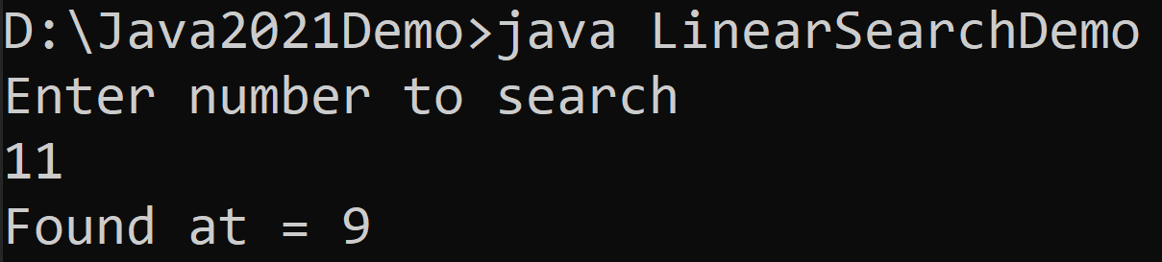
Linear Search
import java.util.Scanner;
public class LinearSearchDemo{
  public static void main(String[] args){
    int[] myArray = {5,3,6,8,4,6,2,8,9,11};
    Scanner sc = new Scanner(System.in);
    System.out.println("Enter number to search");
    int searchNumber = sc.nextInt();
    sc.close();
    boolean flag = false;
    for(int i=0;i<myArray.length;i++){
      if(myArray[i]==searchNumber){
        System.out.println("Found at = "+i);
        flag = true;
        break;
      }
    }
    if(!flag){
    System.out.println("Number does not exist in array");
    }
  }}

Slide 30
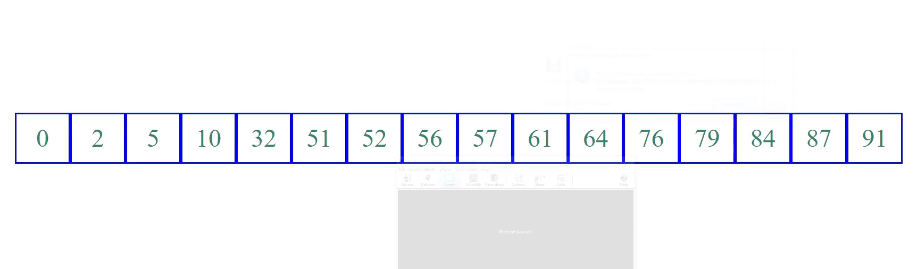
Binary Search (Animation)

Slide 31
Binary Search
import java.util.Scanner;
public class BinarySearchDemo {
public static void main(String[] args) {
  int[] myArray
  = {2,3,5,6,8,9,11,18,29,65};
  Scanner sc = new Scanner(System.in);
  System.out.println
  ("Enter number to search");
  int searchNumber = sc.nextInt();
  sc.close();
  int low = 0;
  int high = myArray.length - 1;
  boolean isFound = false;
  while(high>=low) {
    int mid = (high + low) / 2 ;
    if(searchNumber < myArray[mid]) {
    high = mid - 1;
    }
    else if(searchNumber == myArray[mid]) {
      System.out.println("Found at = "+mid);
      isFound = true;
      break;
    }
    else {
    low = mid + 1;
    }
  }
  if(!isFound) {
  System.out.println
  ("Number does not exist in array");
  }
}
}

Slide 32
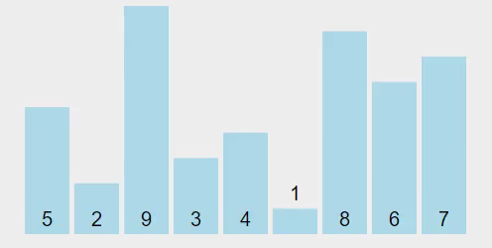
Sorting Array
Sorting, like searching, is a common task in computer programming. Many different algorithms have been developed for sorting.
There are many sorting techniques available, we are going to explore selection sort.
Selection sort
  finds the smallest number in the list and swaps it with the first element.
  It then finds the smallest number remaining and swaps it with the second element, and so on, until only a single number remains.

Slide 33
Selection Sort (Example)
int a[] = { 5, 2, 9, 3, 4, 1, 8, 6, 7 };
for (int i = 0; i < a.length - 1; i++) {
  // Find the minimum in the list[i..a.length-1]
  int currentMin = a[i];
  int currentMinIndex = i;
  for (int j = i + 1; j < a.length; j++) {
    if (currentMin > a[j]) {
      currentMin = a[j];
      currentMinIndex = j;
    }
  }
  // Swap a[i] with a[currentMinIndex] if necessary
  if (currentMinIndex != i) {
    a[currentMinIndex] = a[i];
    a[i] = currentMin;
  }
}
for(int temp: a) { // this is foreach loop
System.out.print(temp + ", ");
}

Slide 34
Function
Functions in Java are blocks of code that perform a specific task, and they are used to organize code and make it more modular and reusable.
Types of Functions are as below:
Pre-Defined Function ( Built-in Library Function):
  In Java, predefined function are the method that is already defined in the Java class libraries is known as predefined function. It is also known as the standard library function or built-in function. We can directly use these functions just by calling them in the program at any point.
User Defined Function:
  The function written by the user or programmer is known as a user-defined function. These functions are modified according to the requirement.

Slide 35
Function
There are two ways to define user define functions in java:
  Instance Method: Access the instance data using the object name. Declared inside a class.
  Static Method: Access the static data using class name. Declared inside class with static keyword.
//Syntax of Instance Method:
  <access_modifier> <return_type> <method_name>( list_of_parameters)
  {
  //body
  }
//Example:
  public void sayHello() {
  System.out.println("Hello, world!");
  } }
//Function calling statement
  A obj = new A();
  Obj.sayHello();
//Syntax of Static Method:
  <access_modifier> <static keyword> <return_type> <method_name>( list_of_parameters)
  {
  //body
  }
//Example:
  public static void sayHello() {
  System.out.println("Hello, world!");
  } }
//Function calling statement
  sayHello();

Slide 36
Function
Returning Values from a Java Function
  Functions in Java can also return a value, which is specified by the return type of the function. To define a function that returns a value, you simply specify the return type (which can be any data type, including objects) before the function name, like this
//Example:
  public int doubleValue(int a) {
  return a * 2;
  }
//Function calling statement
  int result = doubleValue(5);

Slide 37
Function
Passing Parameters to a Java Function
  Functions can also take one or more parameters, which are passed in as values when the function is called. To define a function that takes one or more parameters, you simply list them inside the parentheses when you define the function. Here's an example of a function that takes two parameters (both of type "int") and returns their sum.
//Example:
  public int add(int a, int b) {
  return a + b;
  }
//Function calling statement
  int result = add(5, 7);

Slide 38

Object Oriented Programming using Java (2304CS302)
Prof. Chirag K Sakhrani
Department of Computer Applications
chirag.sakhrani@darshan.ac.in
8401191184

